Slide 1

Analysis and Predictions of Living Expenditures Across Major USA Metropolises
Philip Ai
https://www.interodigital.com/

Slide 2

Outline
Introduction
Objectives
Implementations
Sample Predictions
Visualizations
Source: https://online.hbs.edu/blog/post/finance-vs-accounting

Slide 3
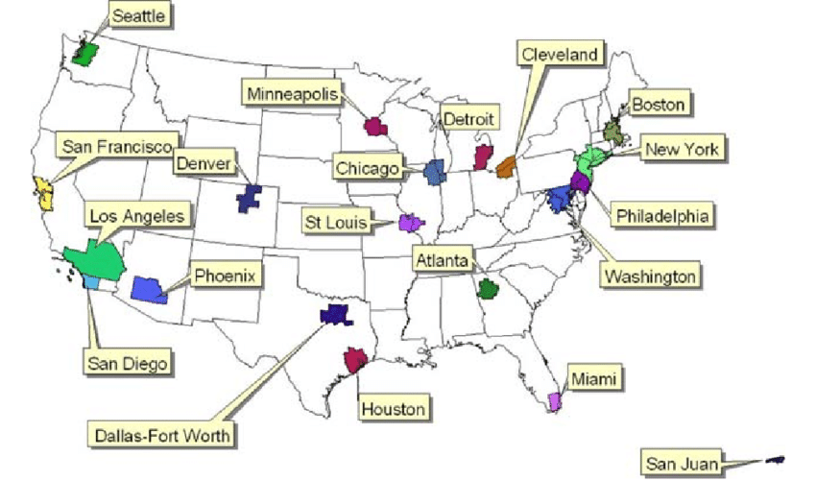
Introduction
United States – 50 states with 20 major metropolitan regions
The degree of expenditures to make a living in each metropolitan region differs
https://www.researchgate.net/figure/Locations-of-the-20-largest-metropolitan-areas-in-the-US-according-to-its-2000-national_fig3_5150999

Slide 4
Objectives
Question 1: Compare the average living expenditures over 20 major US metropolis nationwide.
Question 2: Estimate regional cost of living, based on 4 attributes (Consumer Price Index, household Income, population density, and real estate prices).

Slide 5
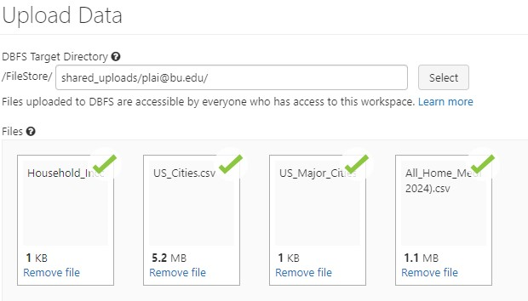
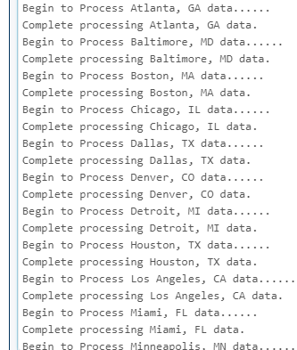
Implementations (Data Loading)

Slide 6
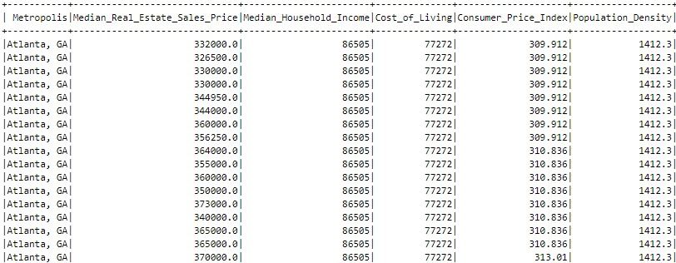
Implementations (Data Preparations)

Slide 7
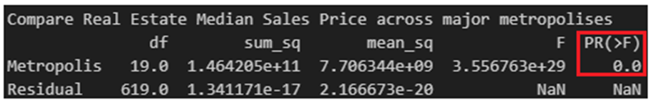
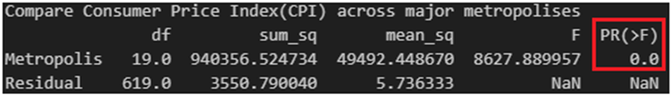
Implementations (ANOVA)

Slide 8
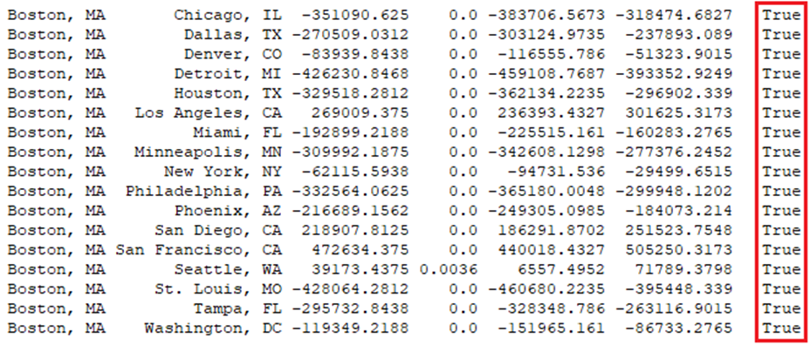
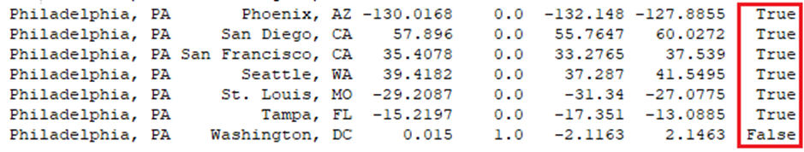
Implementations (Tukey Test)

Slide 9
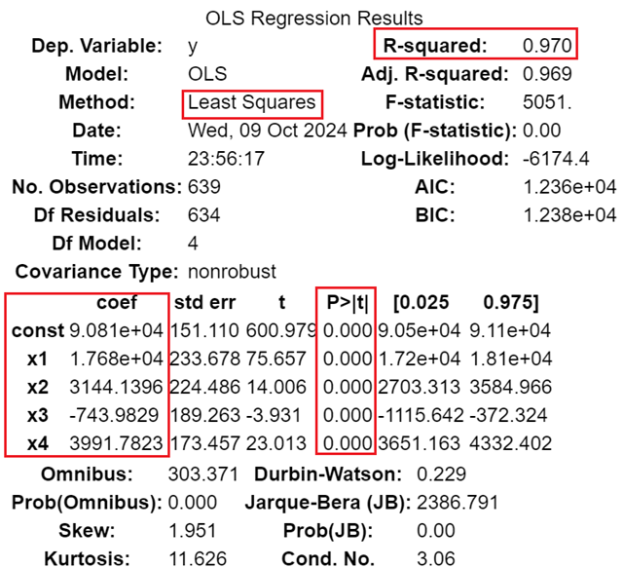
Implementations (Multiple Regression Model)

Slide 10
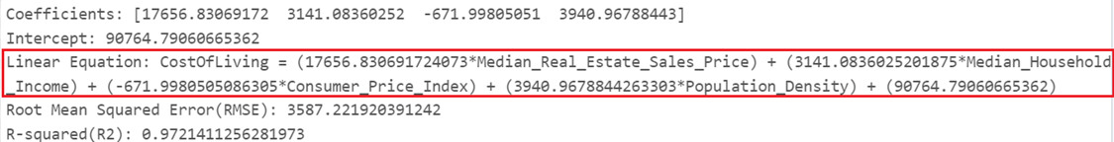
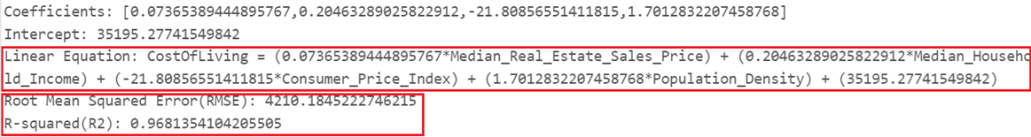
Implementations (Multiple Regression Model)

Slide 11
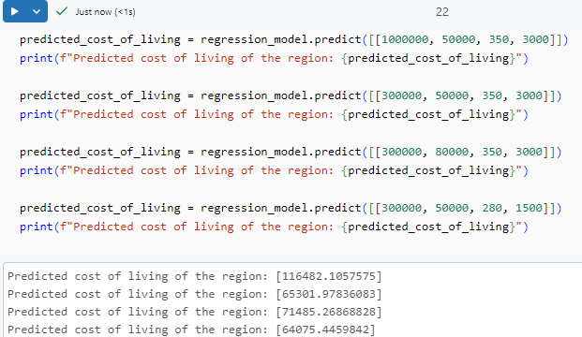
Sample Predictions

Slide 12
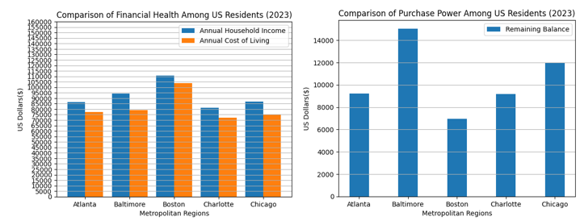
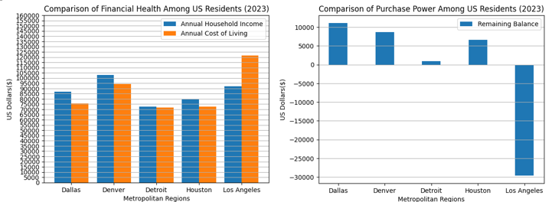
Visualizations

Slide 13
